Slide 1
Fake News Prediction using ML
Mentor - Mr. Sandeep Sangle sir

Slide 2


Slide 3
Abstract
The advent of the World Wide Web and the rapid adoption of social media platforms (such as Facebook and Twitter) paved the way for information dissemination that has never been witnessed in the human history before. With the current usage of social media platforms, consumers are creating and sharing more information than ever before, some of which are misleading with no relevance to reality. Automated classification of a text article as misinformation or disinformation is a challenging task. Even an expert in a particular domain has to explore multiple aspects before giving a verdict on the truthfulness of an article. In this work, we propose to use machine learning ensemble approach for automated classification of news articles. Our study explores different textual properties that can be used to distinguish fake contents from real. By using those properties, we train a combination of different machine learning algorithms using various ensemble methods and evaluate their performance on 4 real world datasets. Experimental evaluation confirms the superior performance of our proposed ensemble learner approach.

Slide 4
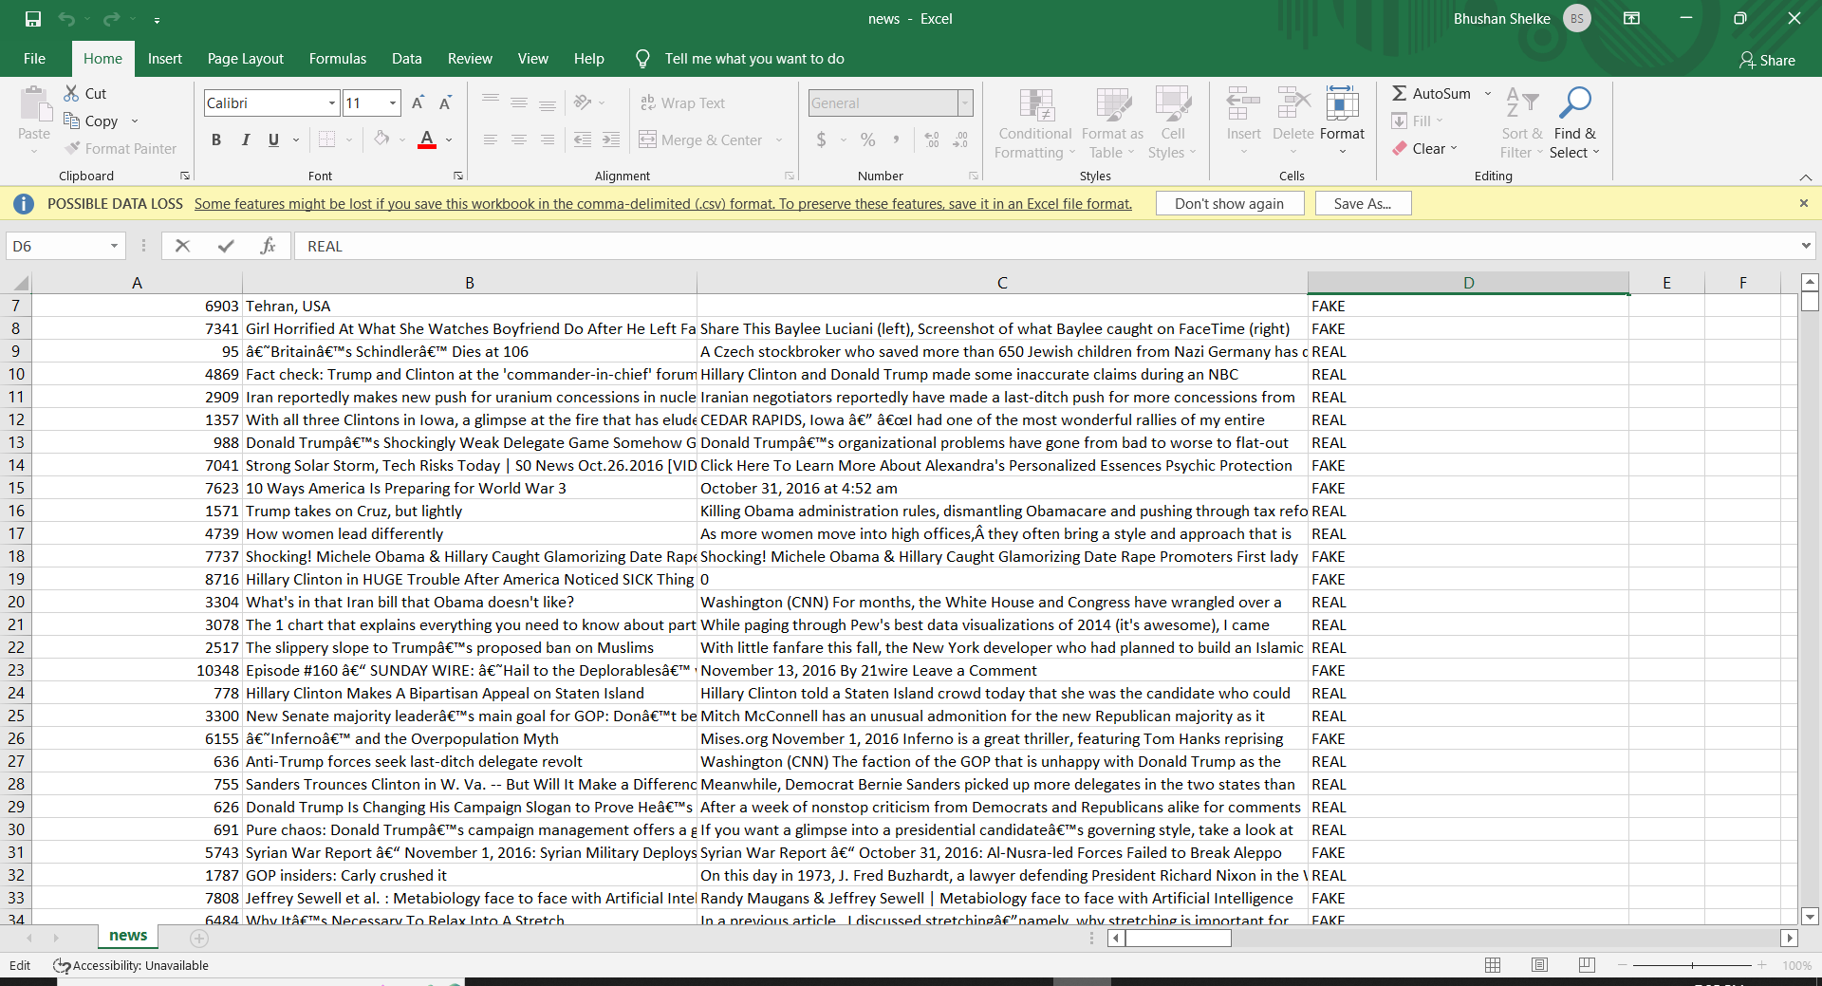
Dataset

Slide 5
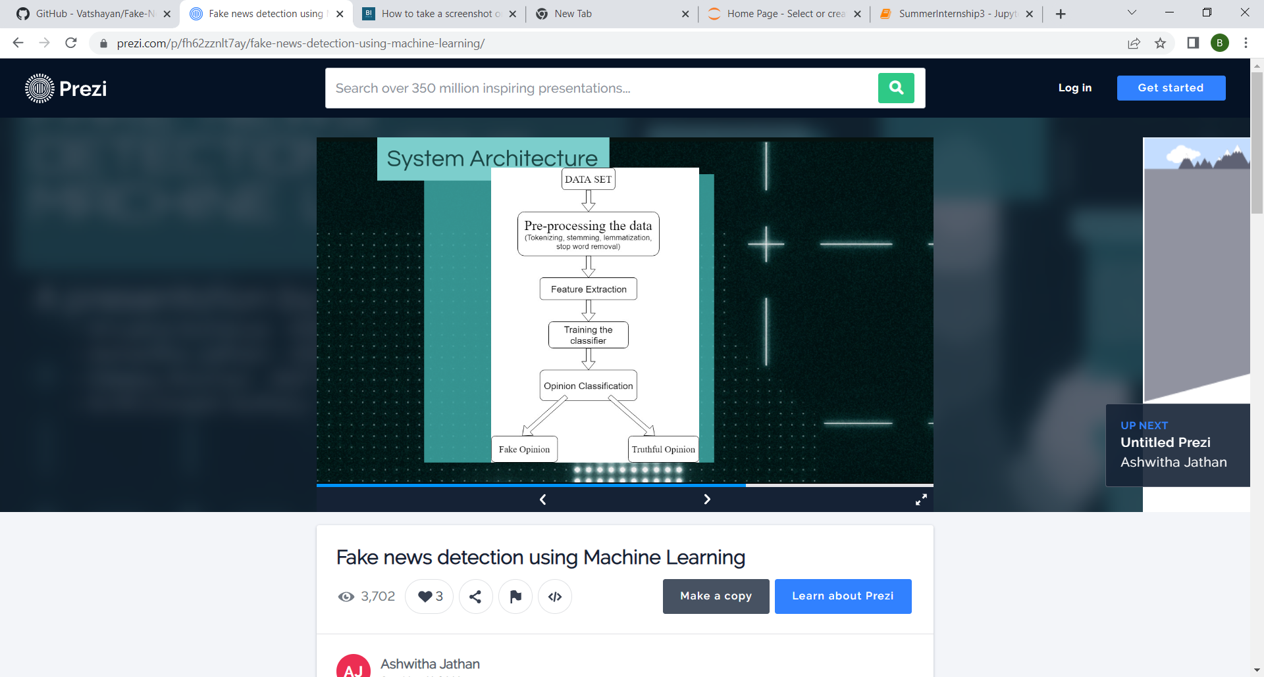
System Architecture

Slide 6
Libraries for data pre-processing:
Pandas
os
Scikit-Learn -> Model Selection -> Train- Test Split
Scikit-Learn -> Linear Model -> Passive Aggressive Classifier
Scikit-Learn -> Feature Extraction text -> TfidfVectorizer
Scikit-Learn -> Metrics -> Accuracy Score & Confusion Matrix

Slide 7
Passive Aggressive Classifier:
In online learning, a machine learning model is trained and deployed in production in a way that continues to learn as new data sets arrive. So we can say that an algorithm like Passive Aggressive Classifier is best for systems that receive data in a continuous stream.
It remains passive for correct predictions and responds aggressively to incorrect predictions.

Slide 8
TfidfVectorizer :
The word count from text documents is very basic at the starting point. However simple word count is not sufficient for text processing because of the words like “the”, “an”, “your”, etc. are highly occurred in text documents. Their large word count is meaningless towards the analysis of the text. Tf-idf can be successfully used for stop-words filtering from the text document.
TF-IDF is a numerical statistic which measures the importance of the word in a document.
Term Frequency: Number of time a word appears in a text document.
Inverse Document Frequency: Measure the word is a rare word or common word in a document.

Slide 9
Flask:
Flask is a Python-based micro framework used for developing small-scale websites. Flask is very easy to make Restful APIs using python. As of now, we have developed a model i.e model.pkl .

Slide 10
StopWords:
A stop word is a commonly used word (such as “the”, “a”, “an”, “in”) that a search engine has been programmed to ignore, both when indexing entries for searching and when retrieving them as the result of a search query.
We would not want these words to take up space in our database, or taking up valuable processing time. For this, we can remove them easily, by storing a list of words that you consider to stop words.
Python has a list of stopwords stored in 16 different languages.

Slide 11
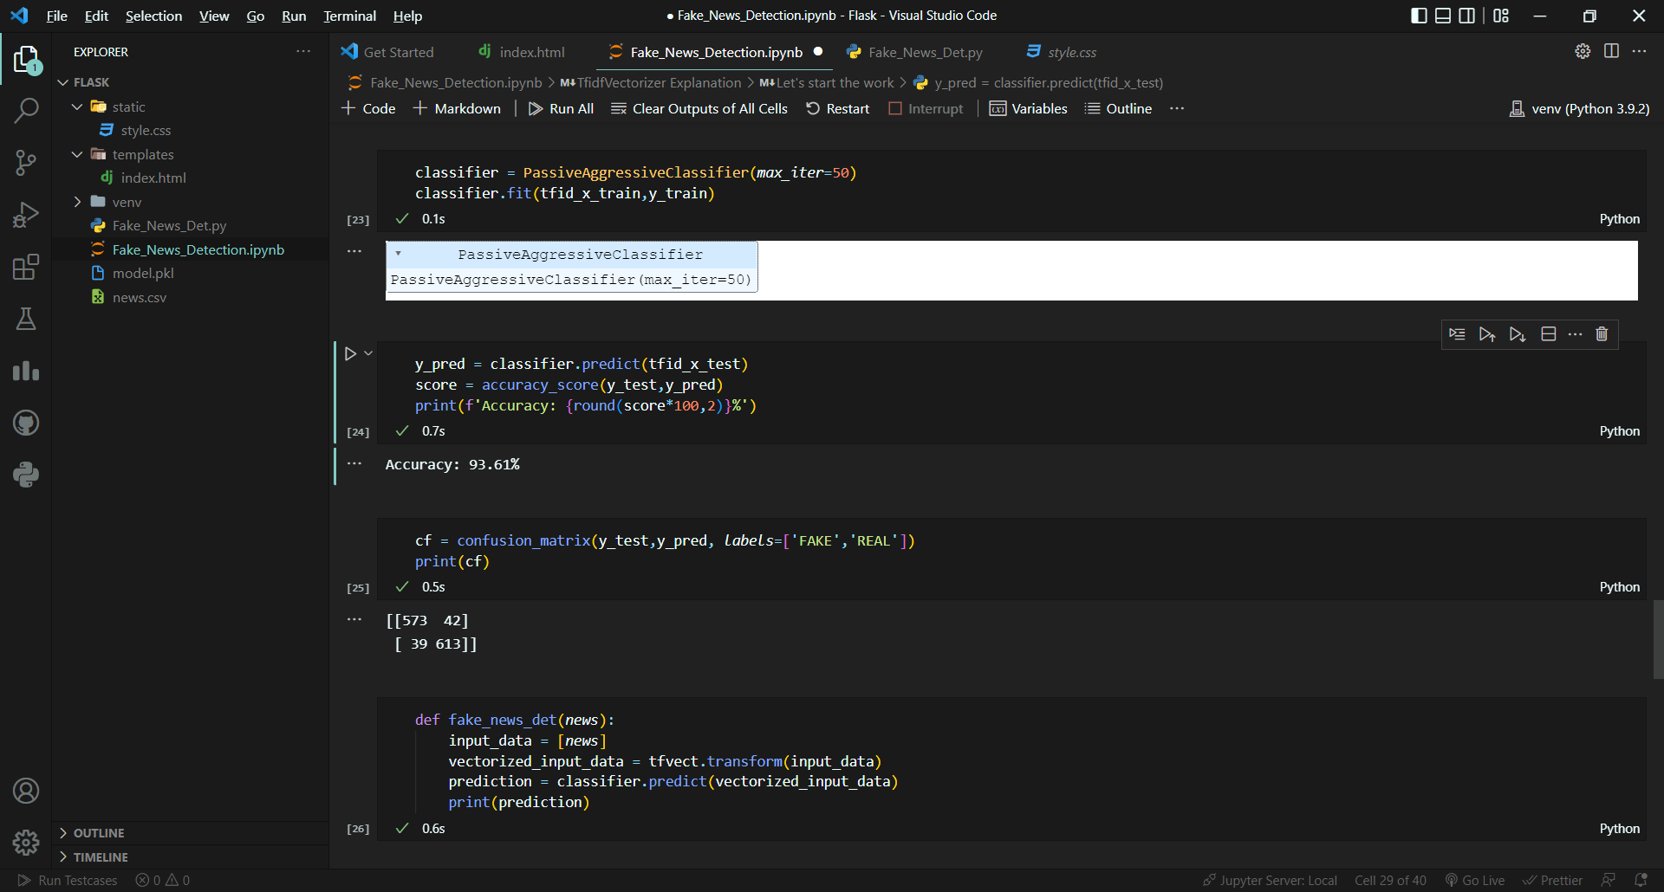
Accuracy Score: 93.61%

Slide 12
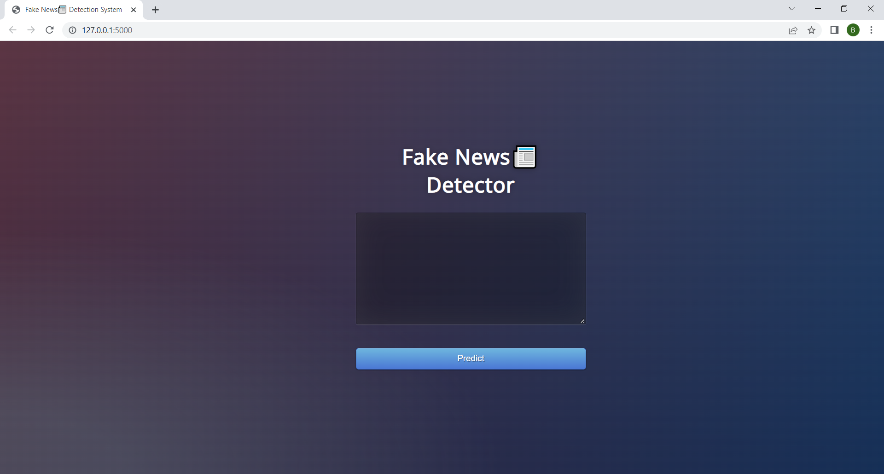
Results :

Slide 13
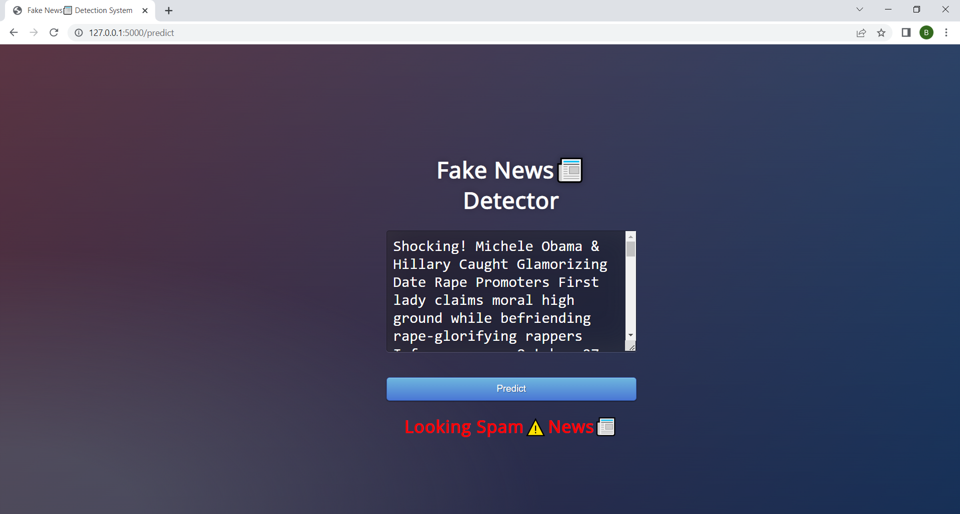

Slide 14
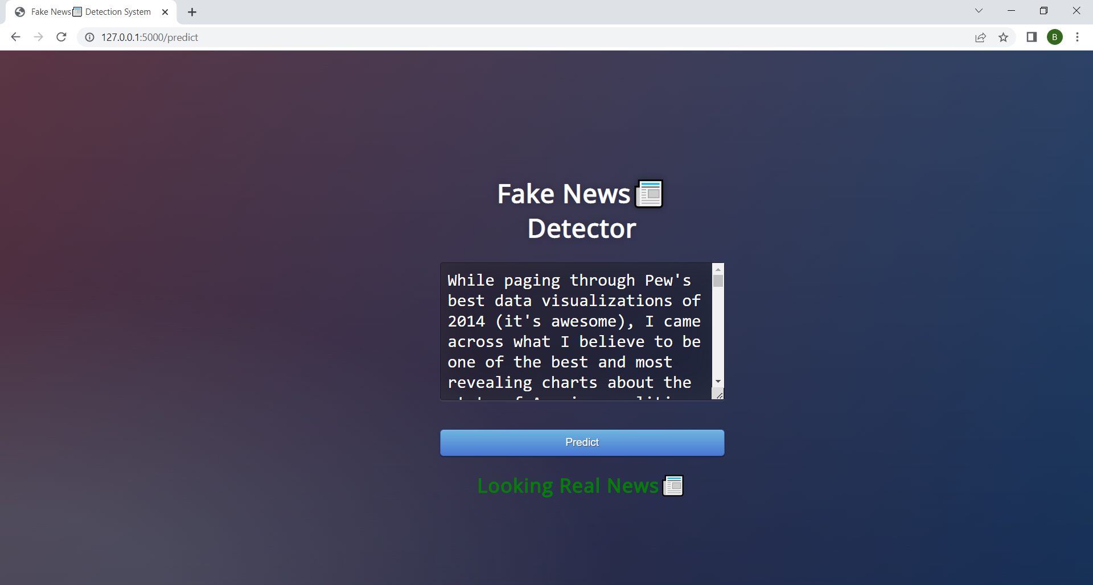

Slide 15
Thank-You!

